Slide 2


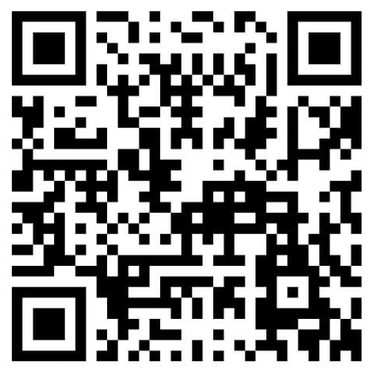






Samik Roy
Cloud Security Architect
https://www.udemy.com/user/samik-roy-9/
https://www.linkedin.com/in/roysamik/
Samik.n.roy@gmail.com
https://youtube.com/@samikroy
https://github.com/samikroy

Slide 3







Gold Partner
Silver Partner

Slide 4
Quick start on Cloud Penetration Testing

Slide 5


Slide 6




INTRODUCTION

Slide 7

DEEP DIVE

Slide 8
DEMO

Slide 9
QnA

Slide 10


Enumeration
INTRODUCTION
High Privilege
External Sharing
CLOUD
BOB THE TESTER

Slide 11
DEEP DIVE
What not to do
Types
Benefits
Best Practices
Tools

Slide 12
Target Customer Assets
Huge Traffic with automated testing
DDOS
Not To Do

Slide 13
Requirement Analysis
Test Plan Creation
Develment of User Case Scenarios
Test Case Creation
Test Execution
Evaluation
Bug / Issue Tracking and Fixing
Testing Completion
WORKFLOW
Week 1
Week 2
Week 3
Week 4
Week 5
Week 6

Slide 14
A
White Box
B
Grey Box
Black Box
C
TYPES

Slide 15
A
Protecting confidential data
B
Lowering business expenses
Achieving security compliance
C
BENEFITS

Slide 16
Map your cloud environment
Understand the cloud shared responsibility model
Define the requirements and roadmap
Establish plans for a worst-case scenario
BEST PRACTICES

Slide 17



TOOLS
Nmap
Metasploit
Burp Suite
Scout Suite

Slide 18
DEMO

Slide 19
Udemdy
Learn Ethical Hacking From Scratch
SEC588: Cloud Penetration Testing
RESOURCES

Slide 20
QnA

Slide 21
THANK YOU

